Slide 1
Memory Management

Slide 2
Functions of Memory Management
To keep track of all free memory locations or allocated and if allocated ,to which process and how much.
To decide the memory allocation policy
To use various techniques and algorithms to allocate and deallocate memory locations

Slide 3
Schemes of Memory Management
Contiguous Real Memory Management
Non Contiguous Real Memory Management
Non contiguous Virtual Memory Management
1.Single contiguous
2. Fixed partition
3.Variable partition
1.Simple Paging
2.Simple segmentation
1. Virtual Memory Paging
2.Virtual memory segmentation

Slide 4
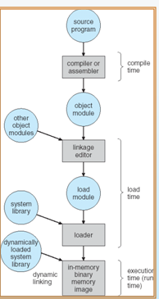
Multistep Processing of a User Program

Slide 5
Binding of Instructions and Data to Memory addresses
Address binding of instructions and data to memory addresses
can happen at three different stages
Compile time:
If memory location is known a priori, absolute code can be generated; must recompile code if starting location changes
Load time:
Must generate relocatable code if memory location is not known at compile time
Execution time:
Binding delayed until run time if the process can be moved during its execution from one memory segment to another. Need hardware support for address maps (e.g., base and limit registers).

Slide 6
Logical vs. Physical Address Space
Logical address – generated by the CPU; also referred to as virtual address
Physical address – address seen by the memory unit
Logical and physical addresses are the same in compile-time and load-time address-binding schemes
Logical (virtual) and physical addresses differ in execution-time address-binding

Slide 7
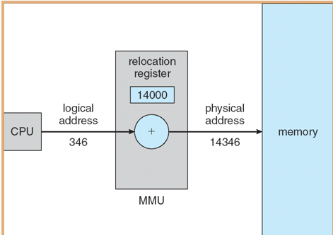
Issues in Memory Management
Relocation and address translation :
1) It is a process of finding physical memory location for a program.
2) One of the need of relocation-
Running program may get swapped out( e.g I/O event)

Slide 8
Issues in Memory Management
Protection :
It refers to the preventing of one program from interfering with other programs.
Reason is “hardware malfunction”.
Sharing:
Multiple processes have to refer to the same memory locations
ex: Word processor. (10 .doc files)

Slide 9
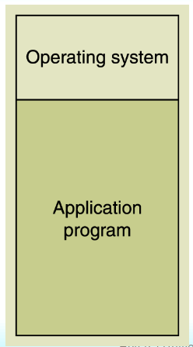
Contiguous Real Memory Management
Only one process is in memory at a time.
a) Relocation and address translation:
No problem of relocation and address translation
b) Protection :
1. mode bit is used (present in hardware)
If mode bit could be 0 –word belongs to OS memory area
If mode bit could be 1–word belongs to User program memory area
Disadvantage-
Additional storage required on disk
2. Fence register
Fence register=p
Contents of MAR and fence register are compared for hardware violation.
c) Sharing of code and data not supported
Fence
Notes:
‹#›

Slide 10
Fixed partition
1) Main memory is divided into partitions.
2) Partition size could be of different sizes.(decided at system generation)
3) OS creates the PDT once static partitions are made.
4) PDT is partition description table.
5) PCB of each process contains Partition ID. This acts a pointer to physical memory location field in PCB.
Partition Id | Starting address | Size | Status
0 | 0 | 100k | Allocated
1 | 100k | 200k | Free
Notes:
‹#›

Slide 11
Actions taken while partition allocation
Long term scheduler decides which process to brought into main memory.
Finds size of process to be loaded.(header of the executable program)
Makes a request for partition allocation routine of Memory Management.
Load the binary program in allocated partition.
Makes a entry of partition id in the PCB.
Make partition status as “Allocated”
The process management schedules this process.

Slide 12
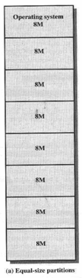
Two difficulties:
1) Program is too big to fit.
Solution is overlay program design
2) Internal fragmentation:
Ex:
If program size is of = 2Mbytes
partition size =8Mbytes.
Wasted area= 6Mbytes.
This wasted area is called as internal fragmentation.

Slide 13
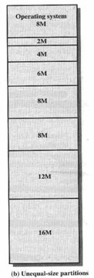
1)Here if program is of 16Mb then can be easily placed without Overlays
2) Less internal fragmentation:
Partition of with 8Mb allow smaller programs to accommodate.

Slide 14
Placement algorithms for Fixed partition
With equal size partition:
1) As partition size are of equal size ,so does not matter which partition is used.(First fit)
2) If all partitions are not free then swapping is used to make space for new process.
With unequal size partition:
1) Scheduling queue is used as per partition to hold swapped out process.
Or
2) Only one queue common to all partitions
Notes:
‹#›

Slide 15
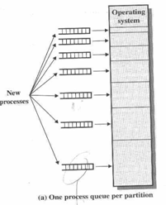
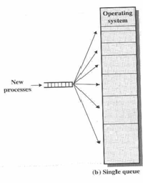

Slide 16
Issues :
1) Relocation:
Two ways of Relocation:
Static relocation
Dynamic relocation.
1) Static relocation:
Compiled Program
Relocating linker/loader
Relocated program with changed addresses

Slide 17
2) Dynamic relocation.
Base register
IR Physical
address
Ex: LDA 500
0
500
1000
1500
2000
2500
1000
500
+
1500
Physical Memory

Slide 18
2) Protection:
This involve use of two things
a) Protection key.
b) Limit register.
a) Protection bits:
1) Say 4 bits are reserved for key and 16 partitions.
2) partition 0 has 0000 protection key and so on
partition 15 has 1111 protection key.
3) Each program has PSW which maintains protection key value of each partition.
4) Whenever process makes any address reference in an instruction, address translation takes place.
5) then protection key of partition and PSW protection key is compared.
6) If not then process is trying to access location from different partition.

Slide 19
a) Disadvantage of Protection bits:
Due to hardware malfunction, if different address get generated of same partition then it is not detected by this method.
b) Limit register:
Base register
<=Limit Register
Yes
+
MAR
Address from
IR
Protection Violation
Error.
Physical Memory
Notes:
‹#›

Slide 20
3) Sharing:
Three solutions were made for sharing:
Keep sharable code or data access through OS, which is very tedious and increases burden of OS.
Keep sharable code or data is placed in all partitions ,but it leads to inconsistencies.
Keep sharable code or data in one partition with controlled access but it needs some complex hardware and program

Slide 21
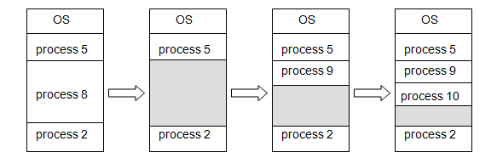
Variable Partition
Hole – block of available memory; holes of various size are scattered throughout memory.
When a process arrives, it is allocated memory from a hole large enough to accommodate it.
Operating system maintains information about: a) allocated partitions b) free partitions (hole)

Slide 22
Actions taken while partition allocation
Long term scheduler decides which process to brought into memory.
Finds size of process to be loaded.(header of the executable program)
Makes a request for partition allocation routine of Memory Management.
Load the binary program in allocated partition.
Makes a entry of partition id in the PCB.
Make partition status as “Allocated”
The process management schedules this process.

Slide 23
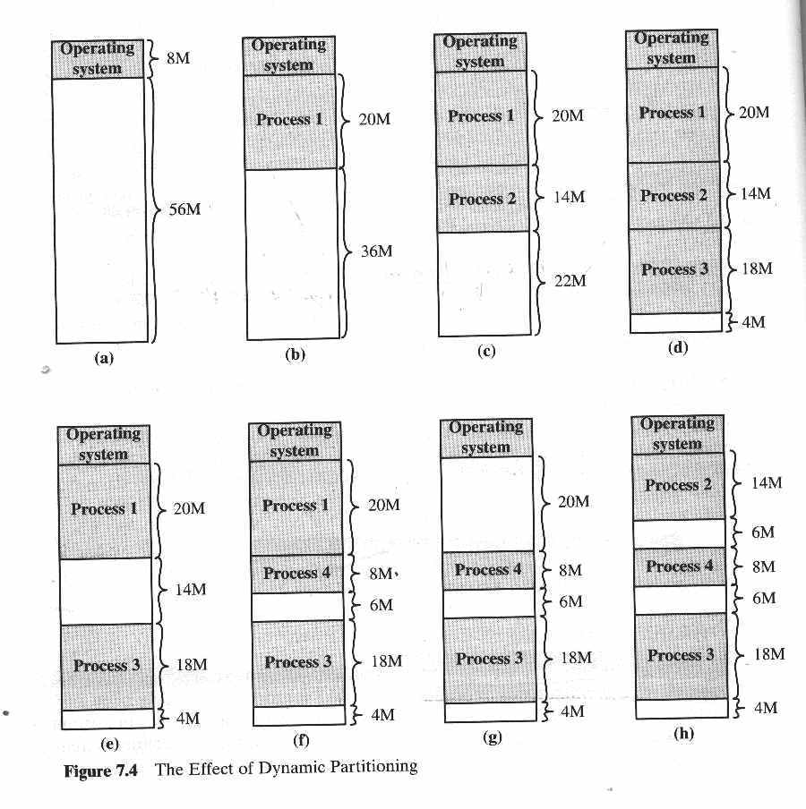
External Fragmentation

Slide 24
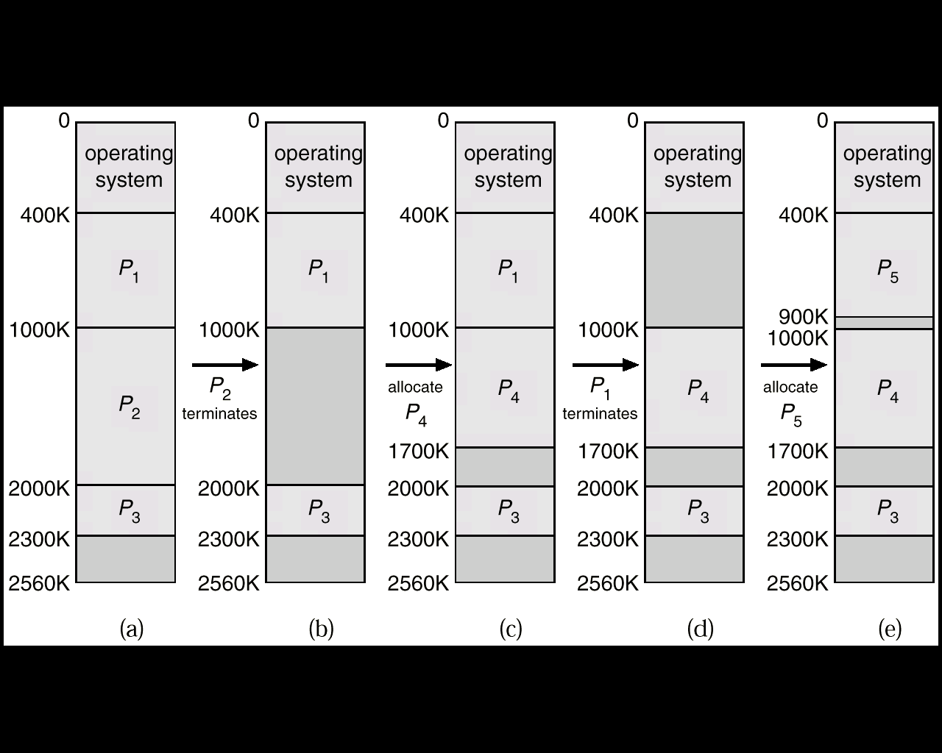
Another example of External Fragmentation

Slide 25
Technique to overcome external fragmentation:
1) Compaction:
All unused area is converted to a contiguous free memory area by shifting processes.
Shifting of processes done by OS.
Disadvantage:
Time consuming and processor time get wasted.
Hence placement algorithms are designed

Slide 26
Placement algorithms for variable partition
First-fit: Allocate the first hole that is big enough.
Best-fit: Allocate the smallest hole that is big enough; must search entire list, unless ordered by size. Produces the smallest leftover hole.
Next-fit: Scan a memory from location of last placement and chooses the next available block that is large enough.
Worst Fit:
a) In this allocation technique, the process traverses the whole memory and always search for the largest hole/partition, and then the process is placed in that hole/partition.
b) It is a slow process because it has to traverse the entire memory to search the largest hole.
Notes:
‹#›

Slide 27
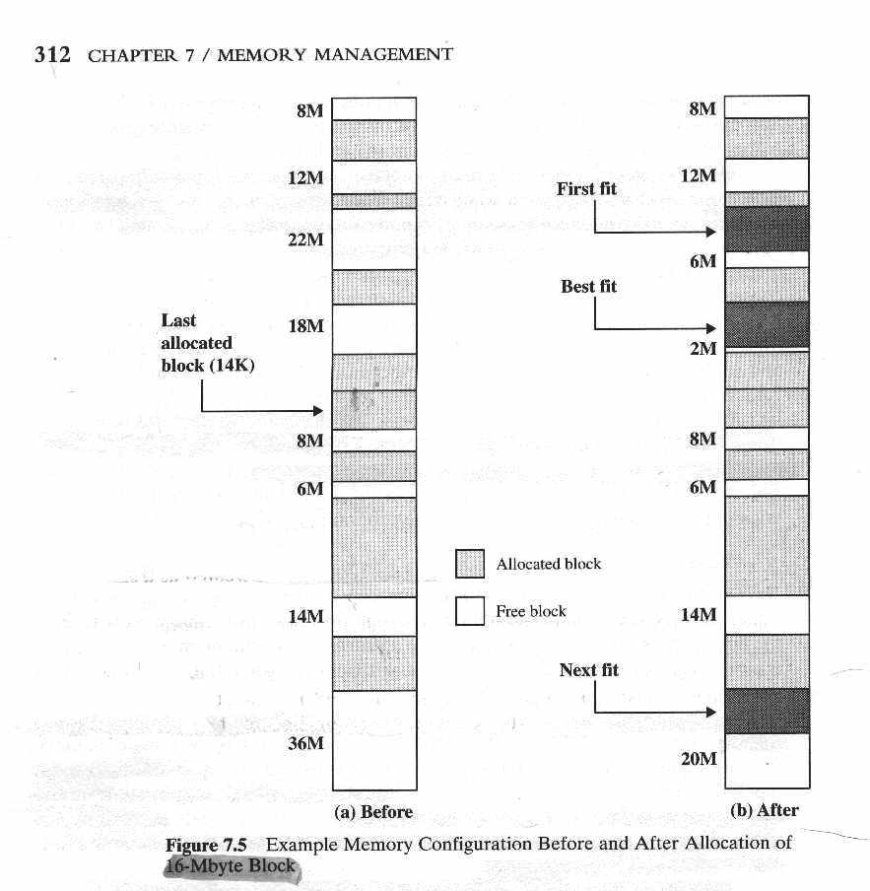
16Mb program comes as allocation request

Slide 28
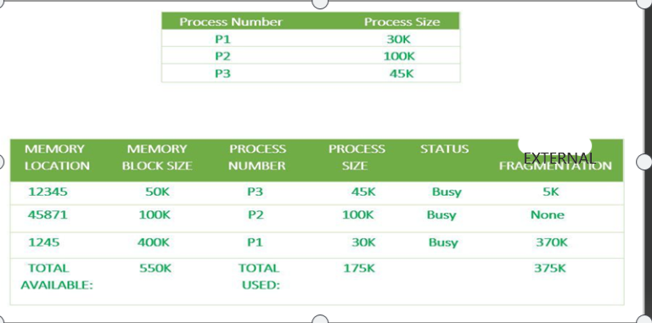
Ex of worst fit
Here Process P1=30K is allocated with the Worst Fit-Allocation technique, so it traverses the entire memory and selects memory size 400K which is the largest,
and
hence there is an external fragmentation of 370K which is very large and so many other processes can also utilize this leftover space.

Slide 29
Issues:
1) Relocation and Address translation
Same as fixed partitions
2) Protection:
Is provided by limit register.
3) Sharing
Here it is provided by overlapping partition.
P1--- base=3000 and limit= 4000
P2 ---base=6000 and limit=3000
So shared area for p1 and p2 is 6000 to 7000.

